Slide 1
DSP w3

Slide 2
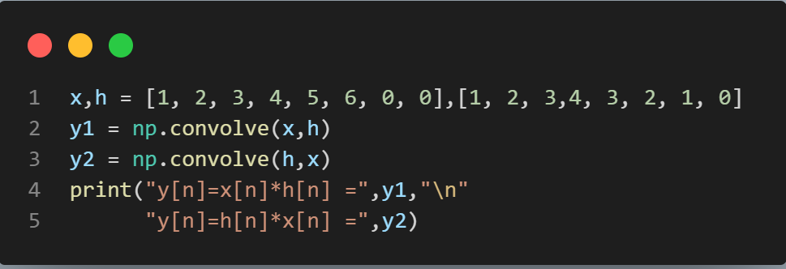

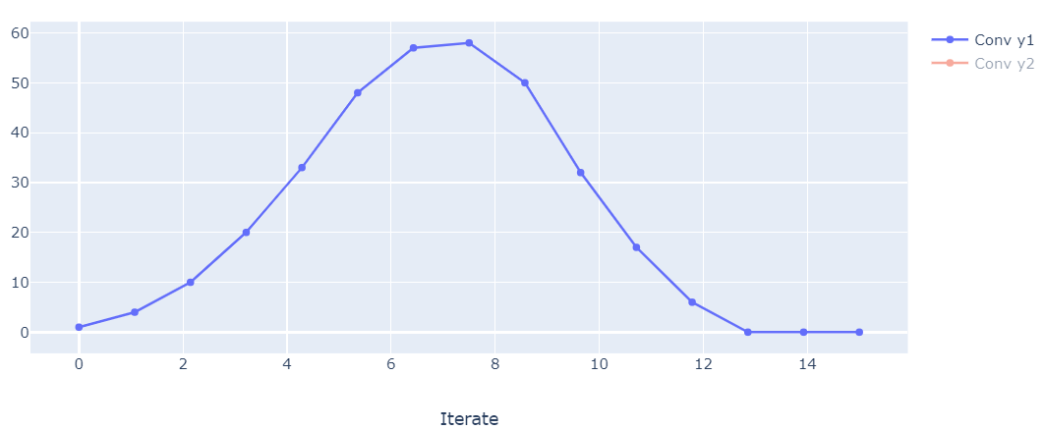
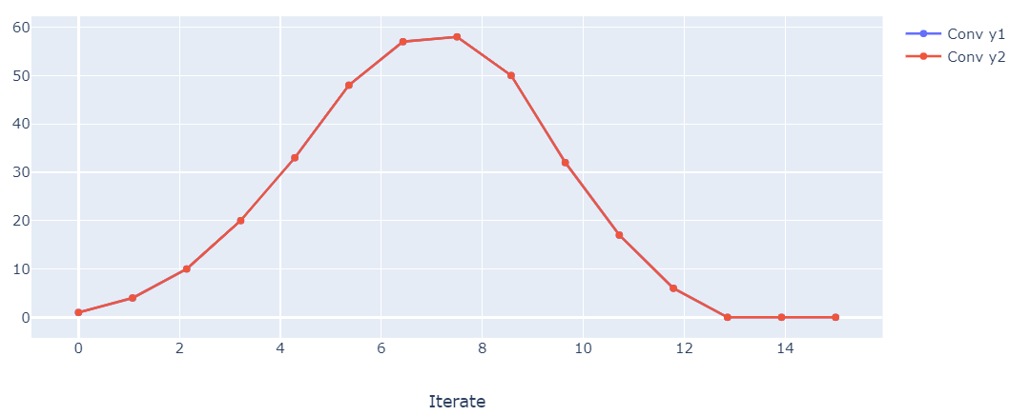
A)
x[n]={1, 2, 3, 4, 5, 6, 0, 0} & h[n]= {1, 2, 3, 4, 3, 2, 1, 0}, Check y[n]=x[n]*h[n] & y[n]=h[n]*x[n] .

Slide 3
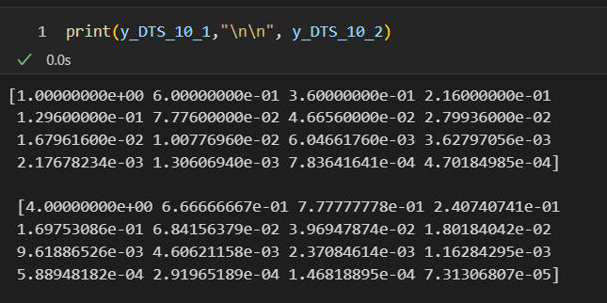
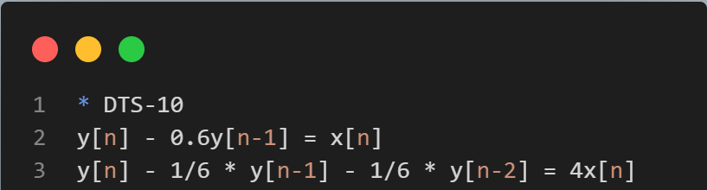
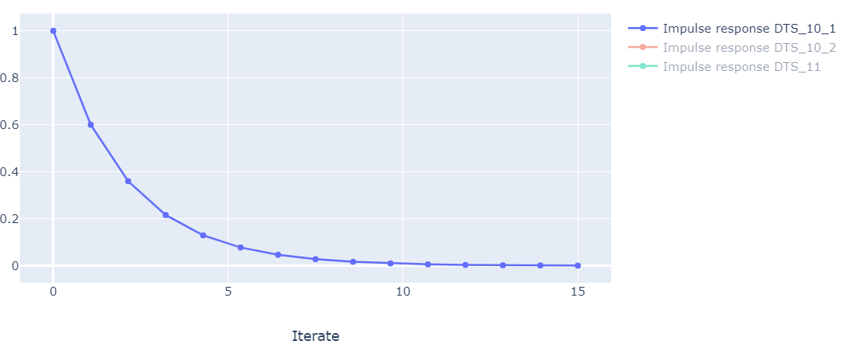
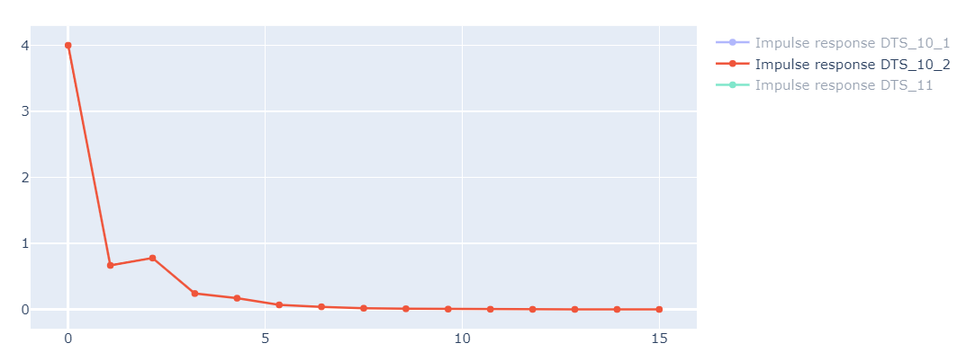
B)
Impulse response of DTS-10 & DTS-11. (at least 16 coeff.)

Slide 4
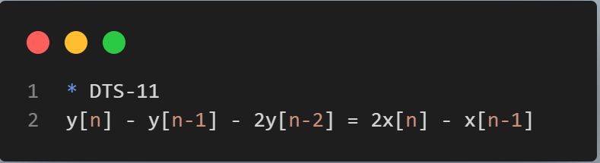

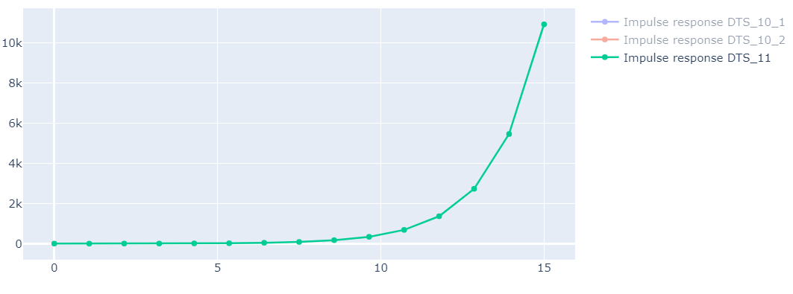
B)
Impulse response of DTS-10 & DTS-11. (at least 16 coeff.)

Slide 5
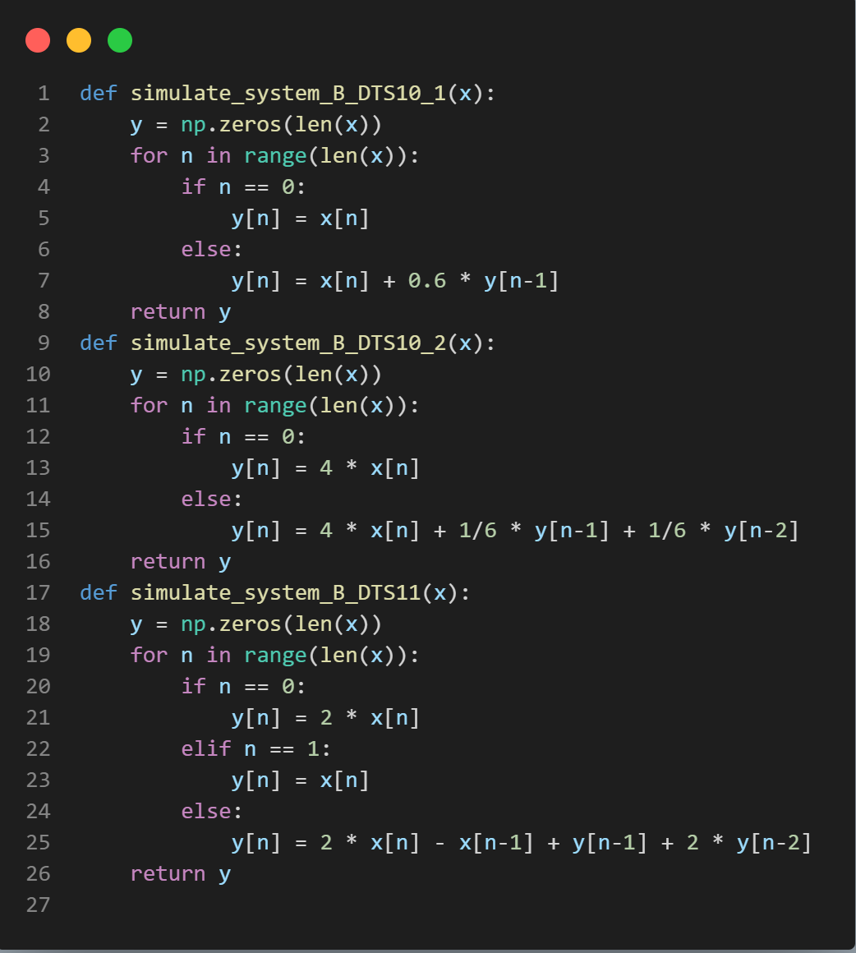
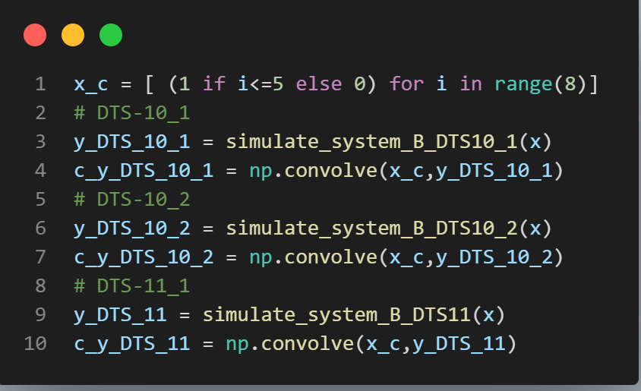
C.)
h[n]=DTS-10 & DTS-11, x[n]={1, 1, 1, 1, 1, 1, 0 ,0}, check y[n].

Slide 6




Slide 7
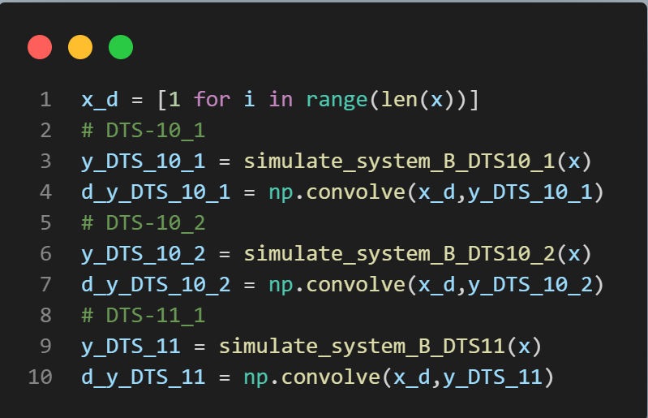
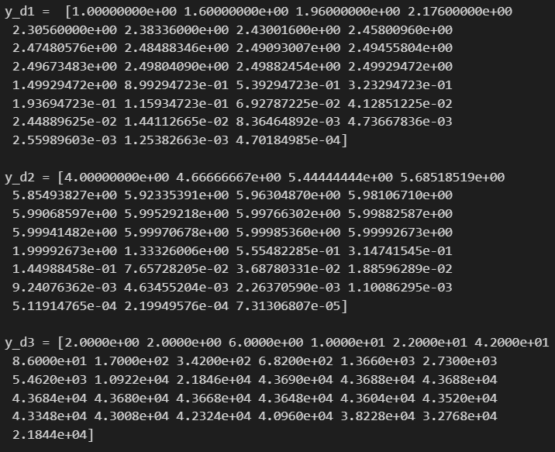



D.)
h[n]=DTS-10 & DTS-11, check the DTS solution for x[n]=u[n].

Slide 8
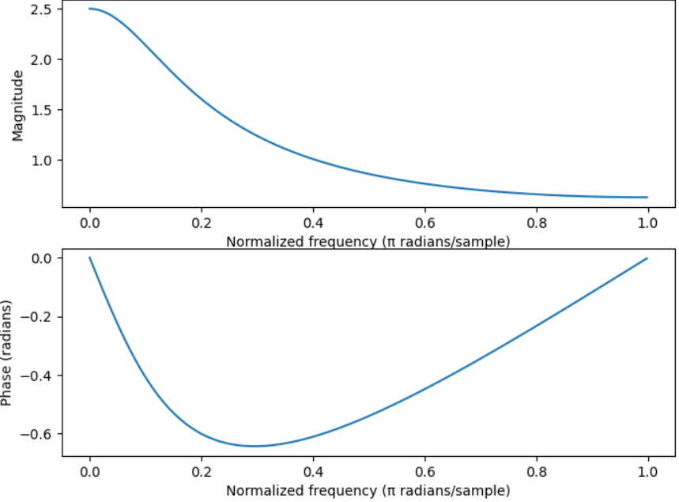
E.)
h[n]=DTS-10 & DTS-11, check the frequency response of DTS.

Slide 9
